Slide 1
Chinese people on the goldfields

Slide 2
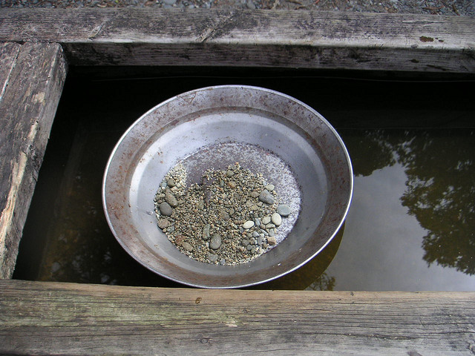
The facts: Working on the gold fields
At first, the main method for mining was alluvial mining.
Alluvial gold was found close to the surface of the ground as small particles mixed with dirt, gravel and clay, or buried in beds of old waterways or leads.
This type of mining required no skill: dirt was sifted and re-sifted with water, or washed in a tin dish, in the hope that gold dust would be revealed.
Alluvial mining required long hours of hard work. The longer the miners worked, the more gold they found.
There were very few ‘wealthy’ miners.
Most miners struggled to earn enough to live.
Life was extremely hard.
Cull, N, http://www.flickr.com/photos/64857724@N00/2876115 CC BY http://creativecommons.org/licenses/by/2.0/deed.en

Slide 3
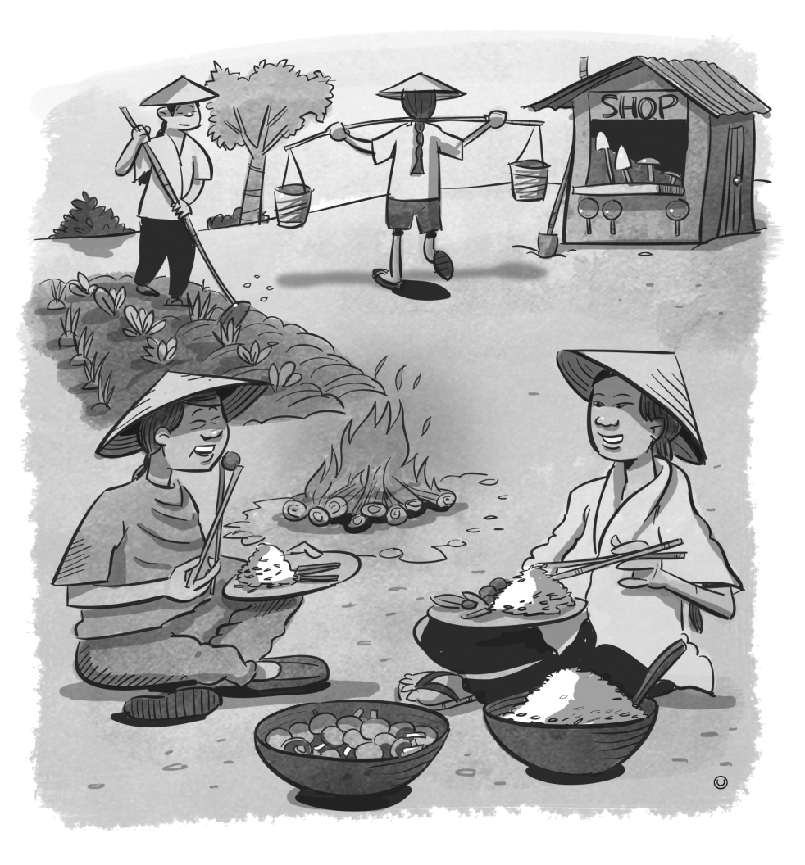
Workers on the gold fields
Chinese miners:
came from rural farms in southern China, escaping drought and famine
were used to:
a simple lifestyle
long hours and hard work
adjusted well to the harsh conditions
worked in organised groups of 30–100 men
worked in abandoned claims of other miners and found the gold those miners had missed
lived in communities
were frugal
accepted lower wages
spoke a foreign language
dressed differently
discovered new gold fields, and were often driven from them.

Slide 4
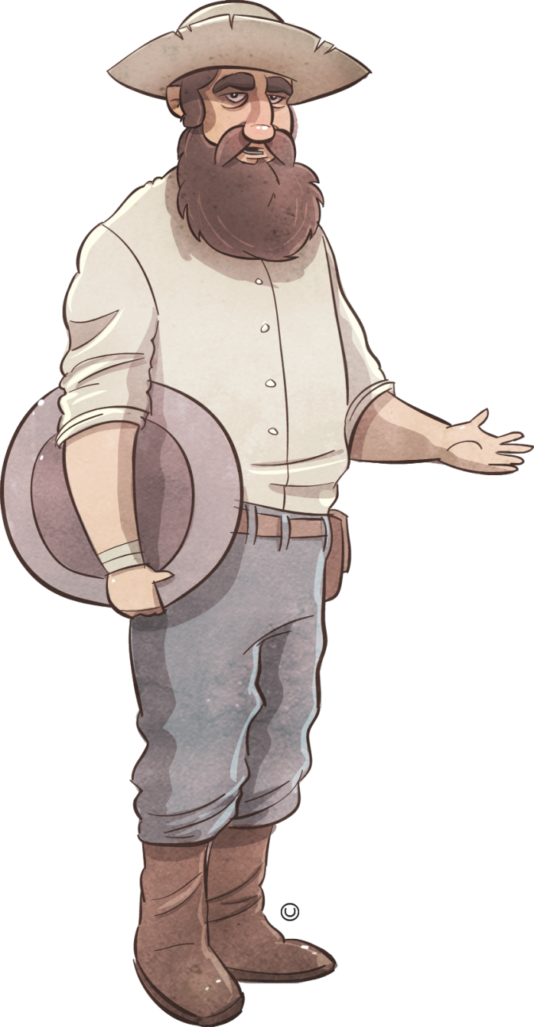
Workers on the gold fields
European miners:
struggled with the harsh conditions on the gold fields
worked alone or in small groups
concentrated on rich patches of ground
quickly abandoned lesser claims to follow rumours of ‘richer diggings’
believed that the Chinese miners:
- muddied waterholes
- were wrong to work on Sundays
- were thieves
- were dirty
- took all the jobs
- were immoral
drove Chinese miners from the gold fields
assaulted Chinese miners
burned Chinese camps.

Slide 5
Identifying perspectives in sources
Source 1: The Lambing Flat banner
This banner was painted on a tent flap and advertised a public meeting to discuss the Chinese miners. It shows the Southern Cross superimposed on the St Andrew’s Cross, which is the national flag of Scotland. The text reads ‘Roll up’ and ‘No Chinese’.
Source 2: Letter from William Loo Ching, Surry Hills, to the editor of the Daily Telegraph, 9 May 1888
‘Treat us not as beasts (as I have seen some of us treated) but bear with us with kindness and civility for this you will get in return; and do not forget that although our skins are yellow we have the same kindred feelings as yourselves and a heart beneath our jumpers which beats the same as any man ...’
William Loo Ching, Letter to the editor Daily Telegraph, 1888 (ABC)
http://www.abc.net.au/cgi-bin/common/printfriendly.pl?/federation/fedstory/ep2/ep2_culture.htm
Jbarta 2012, ‘LambingFlatRollUpBanner’ Wikimedia Commons
http://commons.wikimedia.org/wiki/File:LambingFlatRollUpBanner.jpg

